Slide 1







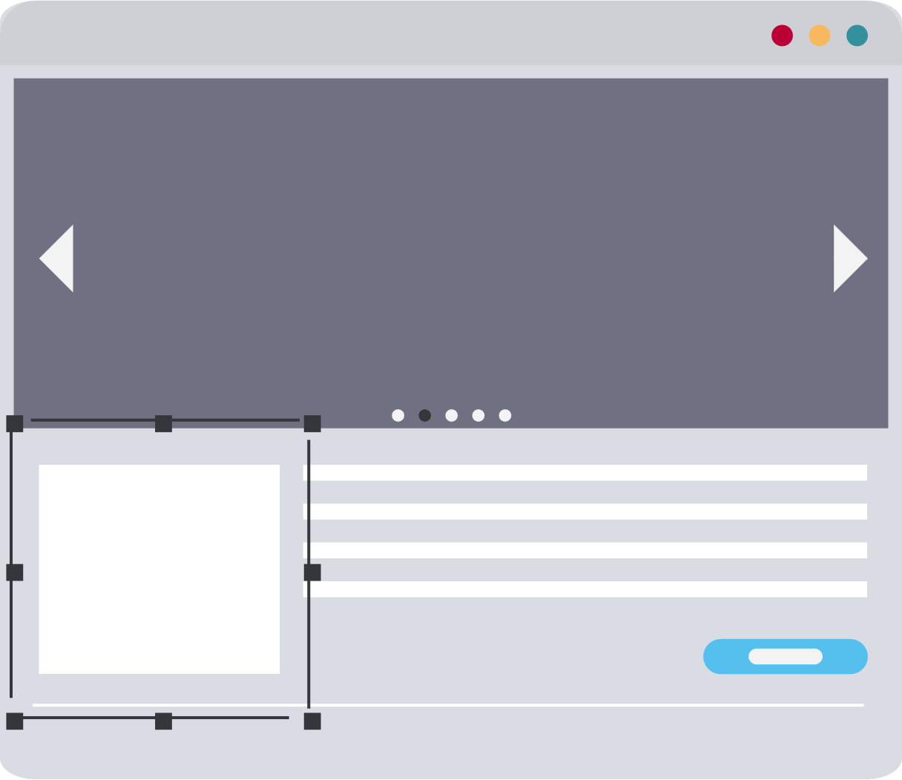

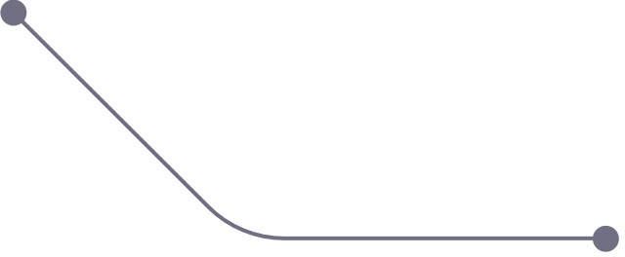
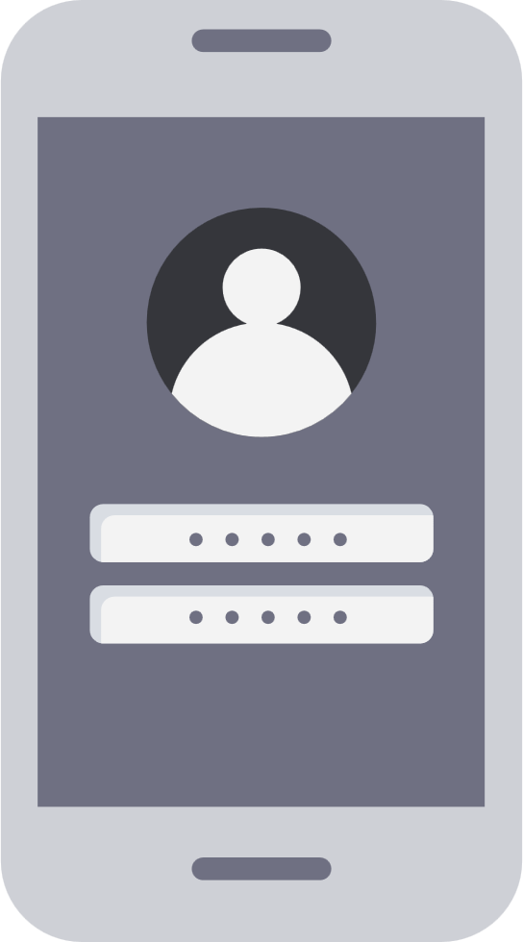

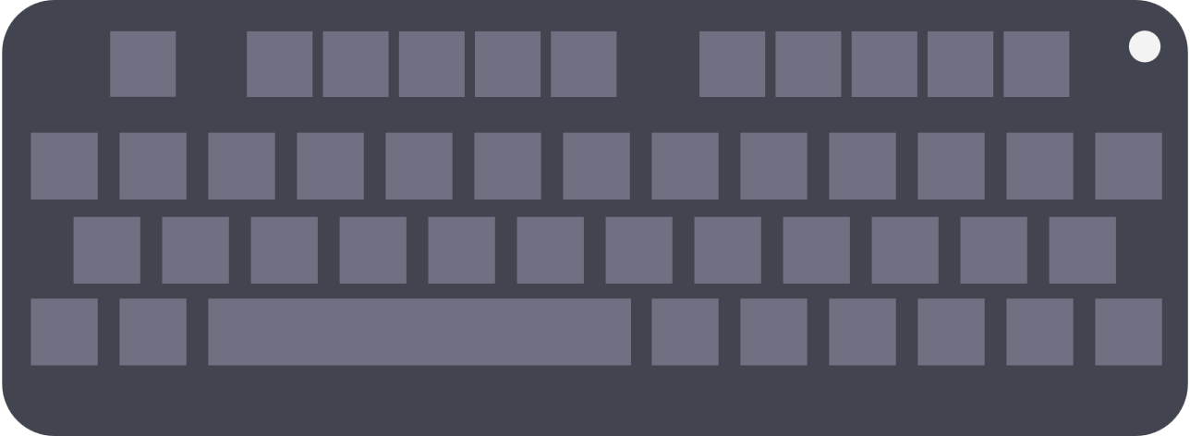

Video Conferencing Application With Speech Transcription
Capstone Project Phase II
Project Number 24-1-D-19
By: Rami Amasha, Moayad Hamza
Supervisor: Mr. Ronen Zilber
Email: rzilberl@gmail.com
1

Slide 2




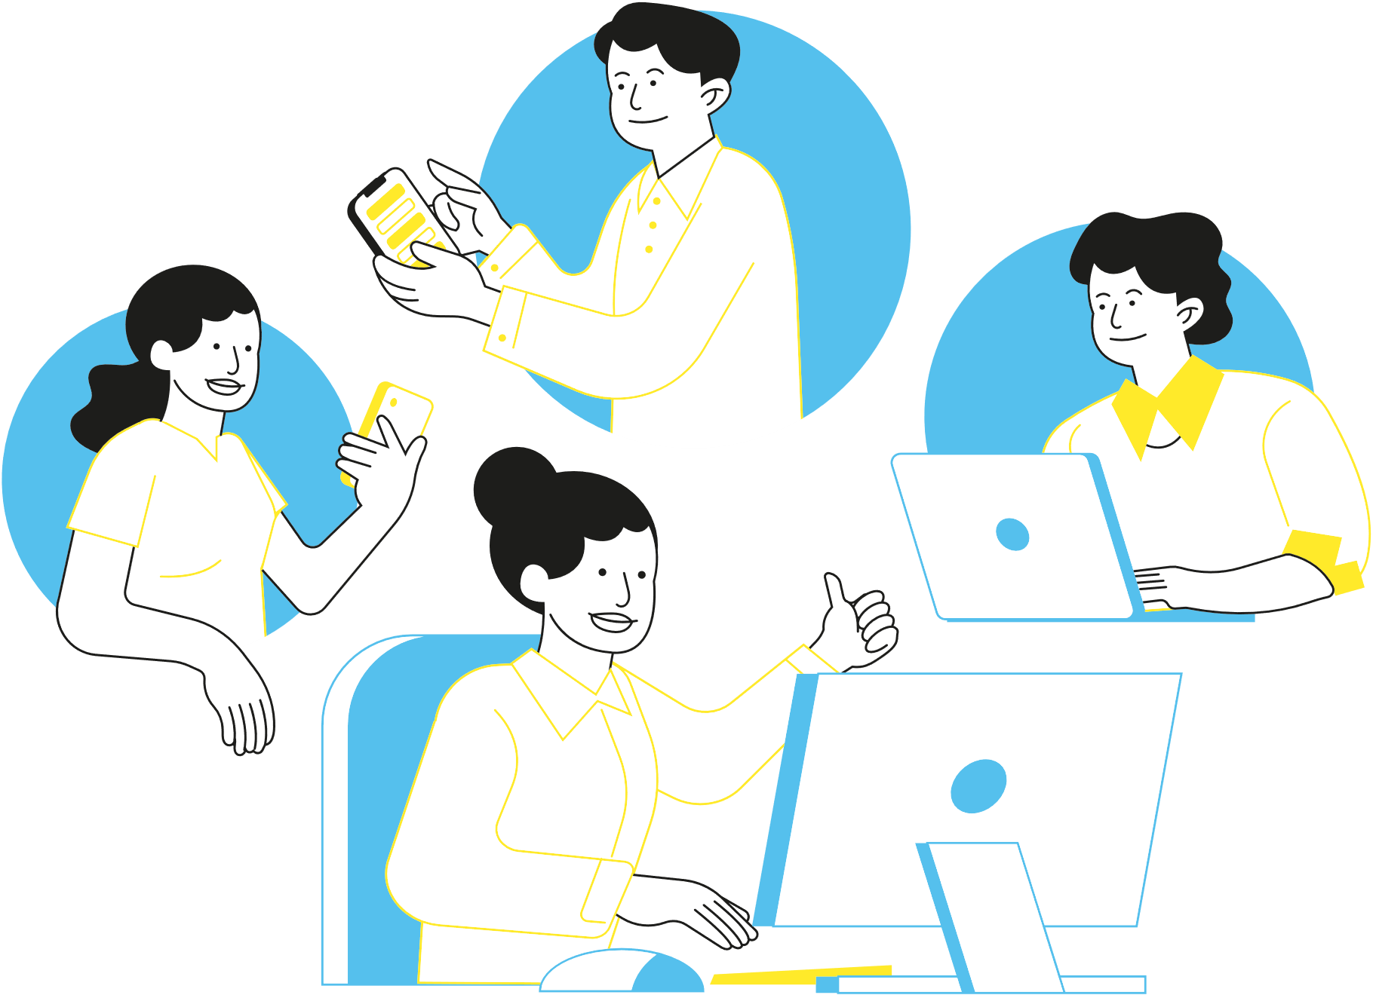

Introduction
After COVID-19 remote conference became more and more popular, but until now all the applications don't have the ability to save the transcript of the conference .
2

Slide 3
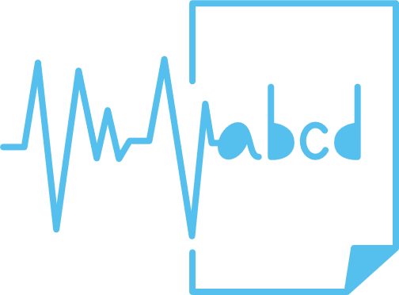
Project Goal
3

Slide 4
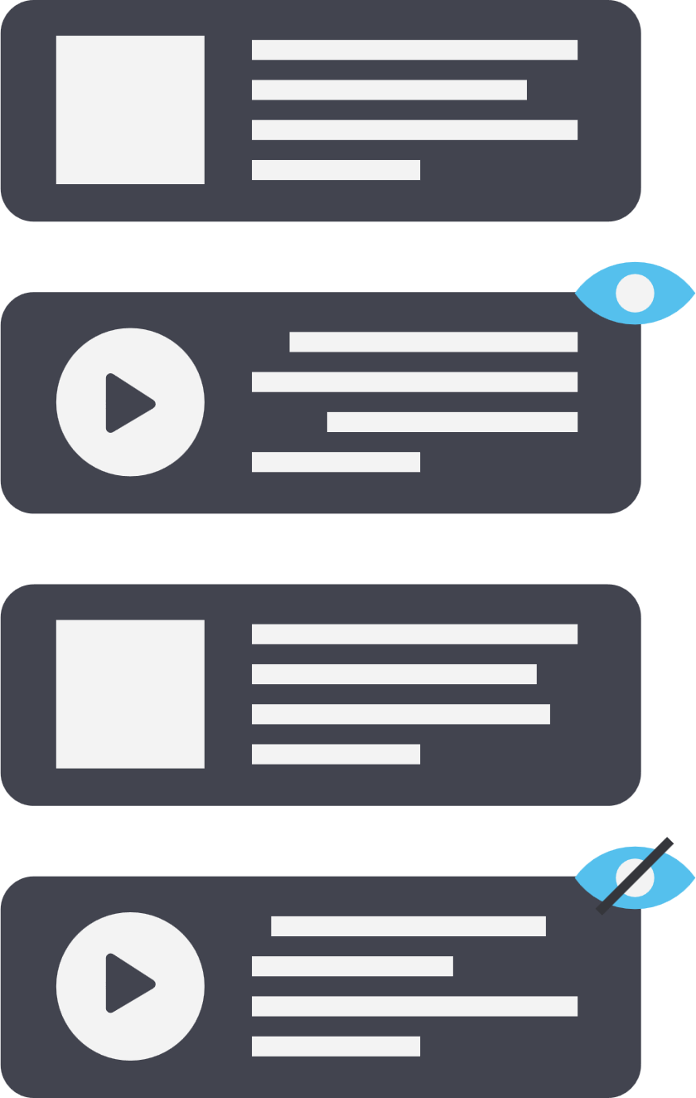
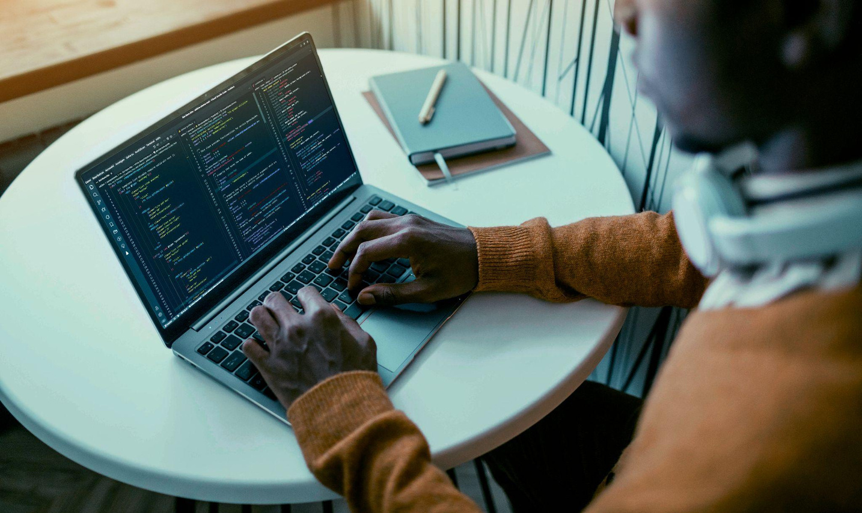





Why we need such system?
Indvidulas with hearing problems
language barriers.
Study and learning.
Note-taking
4

Slide 5


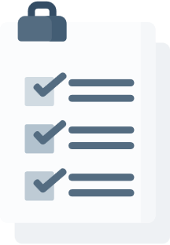


System requirements
Functional
video calls.
meeting controls.
speech-to-text integration.
data privacy.
viewing transcriptions.
5

Slide 6
System requirements
Non-Functional
Low latency and responsivness.
scalability.
Device Compatibility .
User-Friendly Interface.
Maintainability.
6

Slide 7



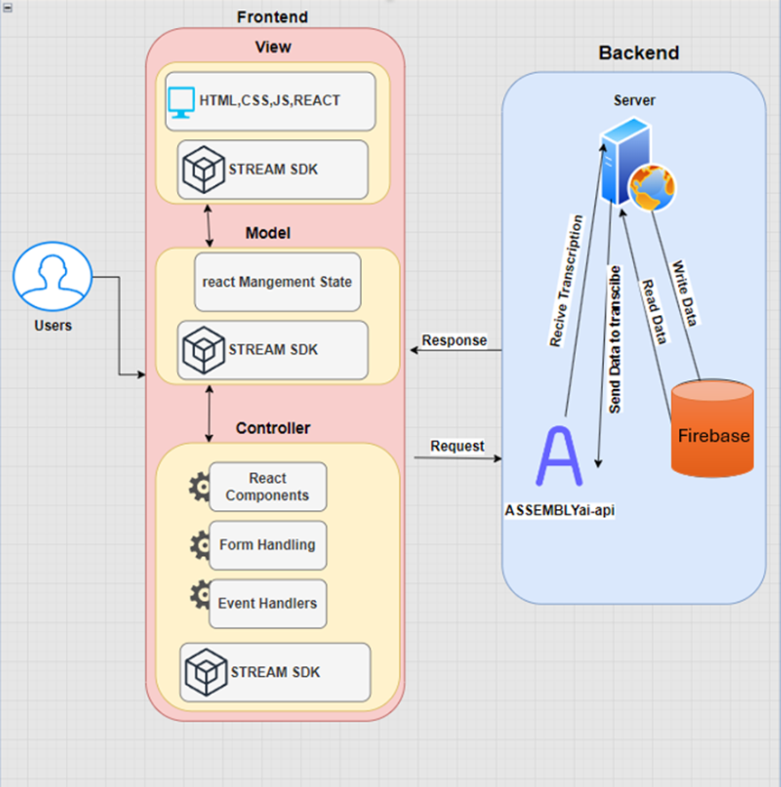
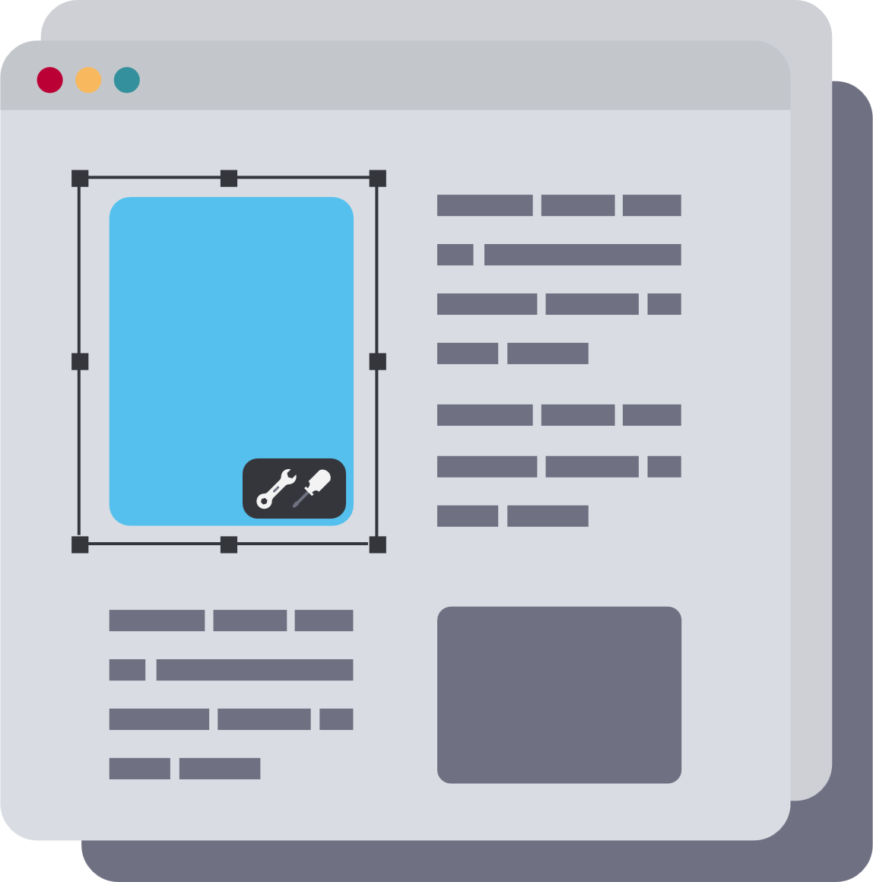


Solution
Description -
Architecture
7

Slide 8
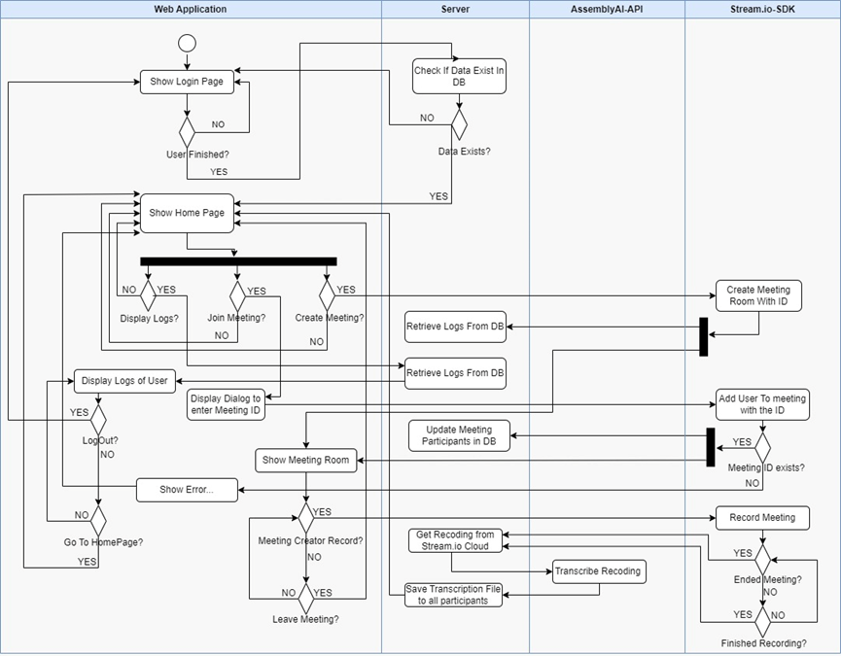
Activity
Diagram
8

Slide 9
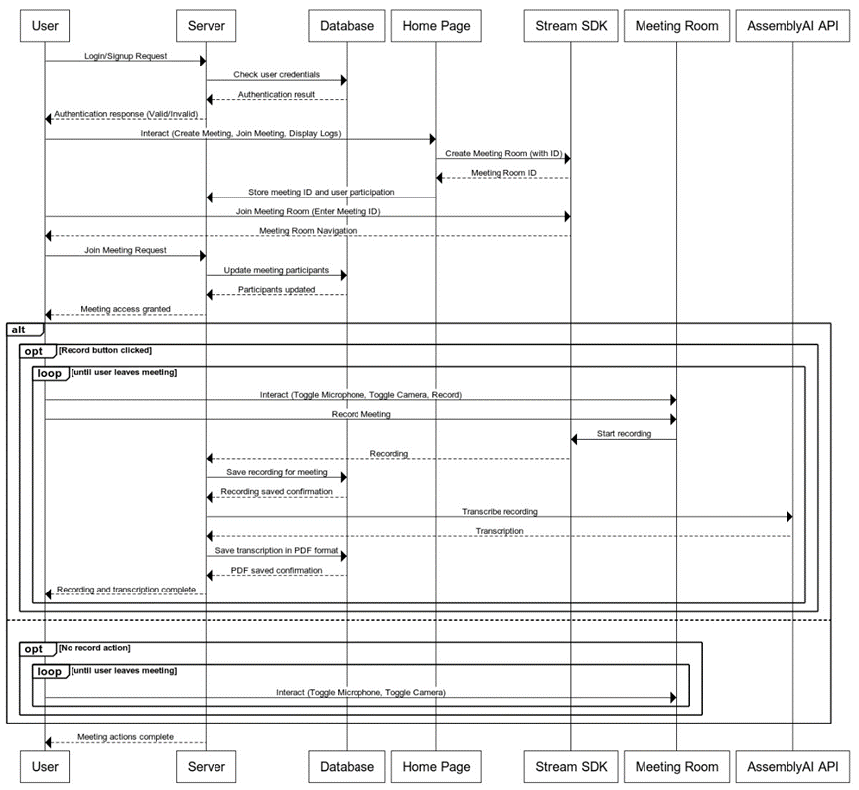
Sequence Diagram
9

Slide 10



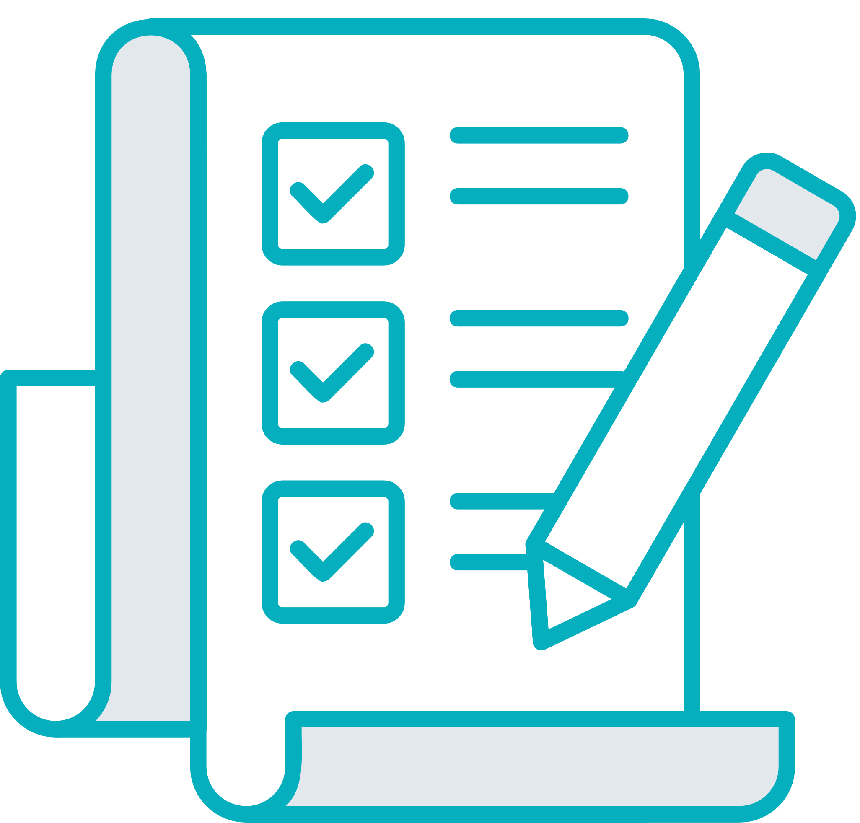




Success Criteria and Achievements
Criterion | Achivement
video calls | create and join meetings
Transcription integration | transcription files
user controls inside meeting | full control
data privacy | user data encrypted
10

Slide 11
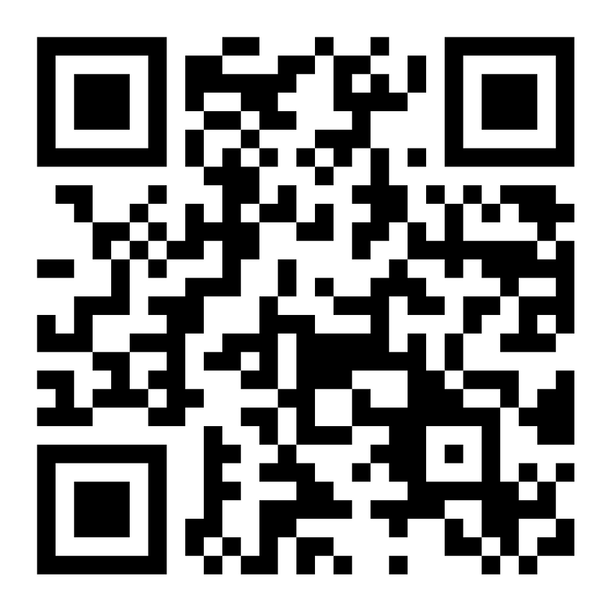
Now, lets see real meeting and check the transcription file generated by the system
11

Slide 12
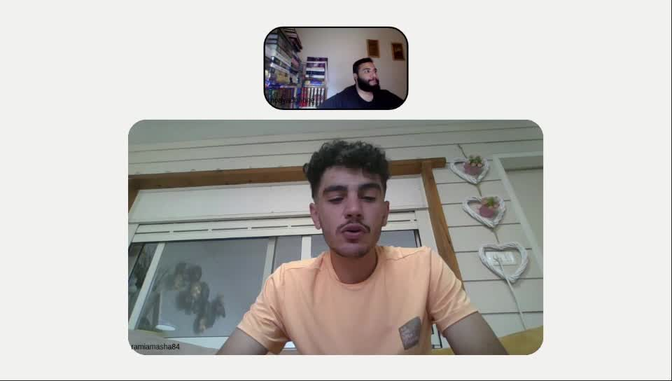
12

Slide 13
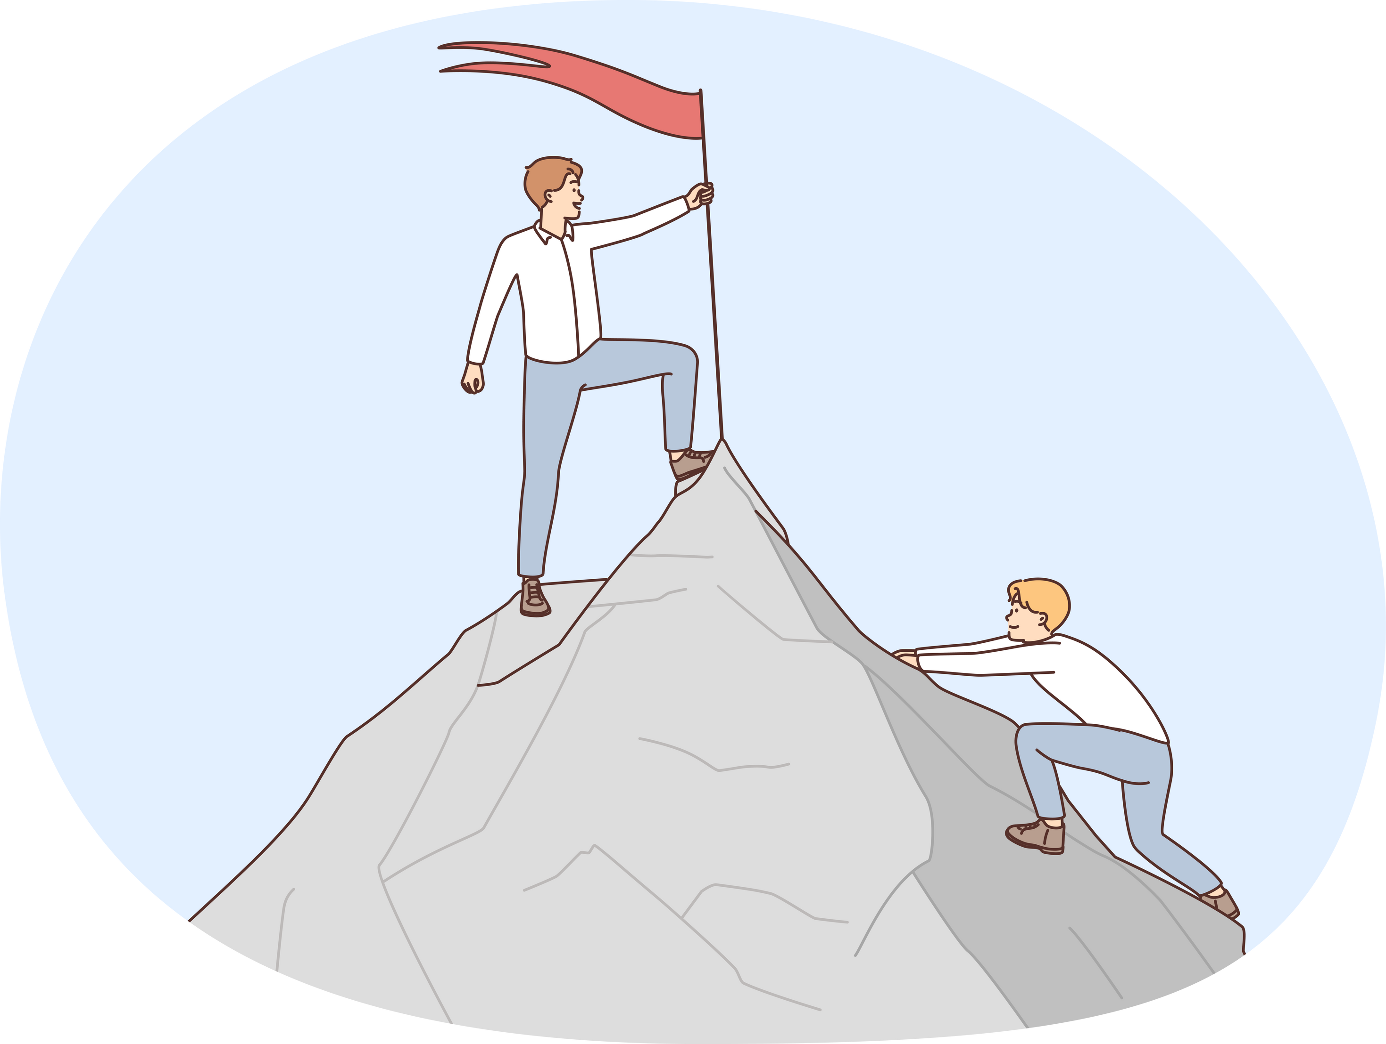
Challenges we faced
Accuracy of Transcriptions.
Sensitive data.
Gateway Timeout Configuration.
13

Slide 14

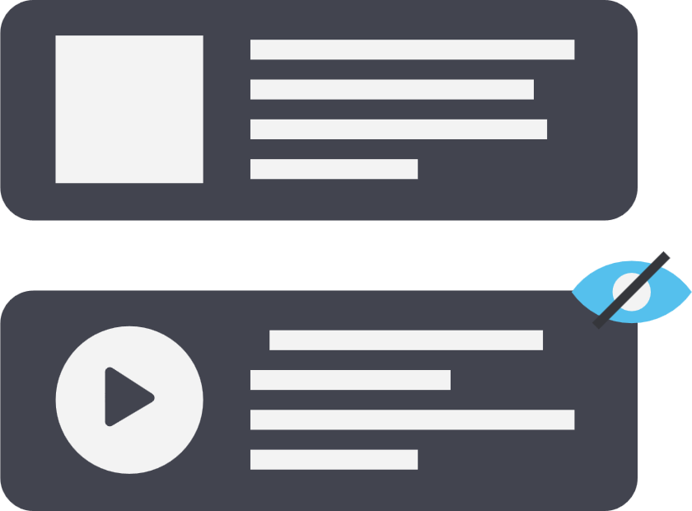
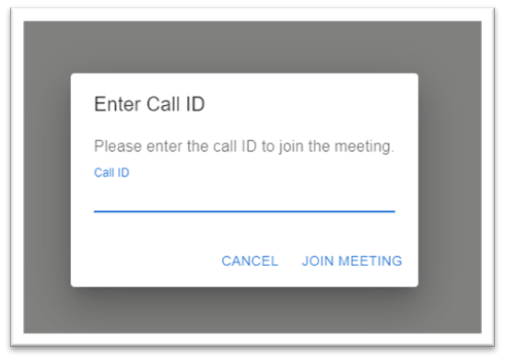

Testing
Test | Tested Function | Expected Result | result
1 | Page load | First page load<2s | lodaing time~400ms
2 | Join meeting process. | A pop-up should appear asking for the meeting ID.
14

Slide 15
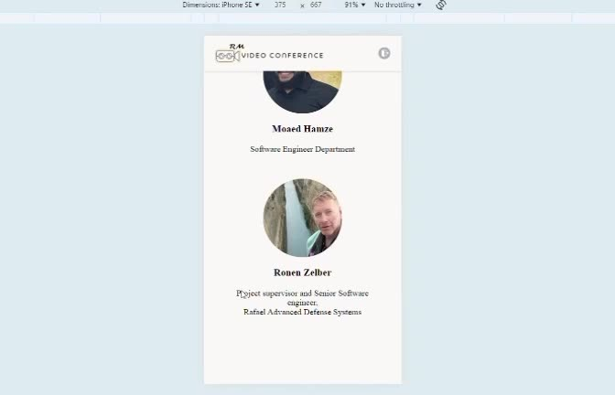
15

Slide 16



Conclusions
Functional achievments.
Performance.
Challenges Addressed.
16

Slide 17

Future work
Improving the UI.
Multilingual website.
Adding chat messagnig between users.
Real-Time transcript.
17

Slide 18
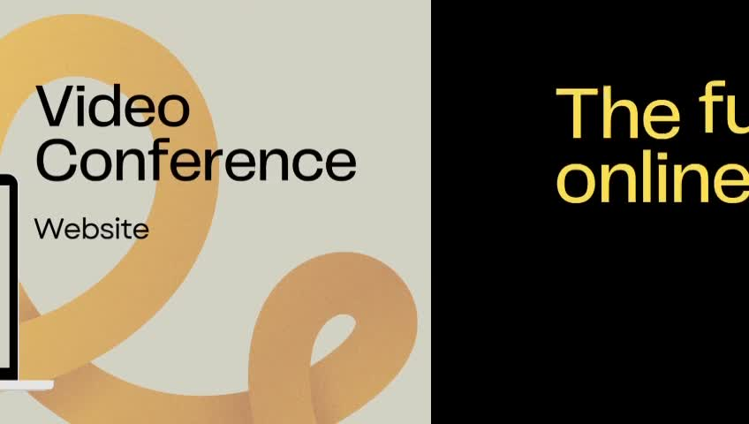
18

Slide 19

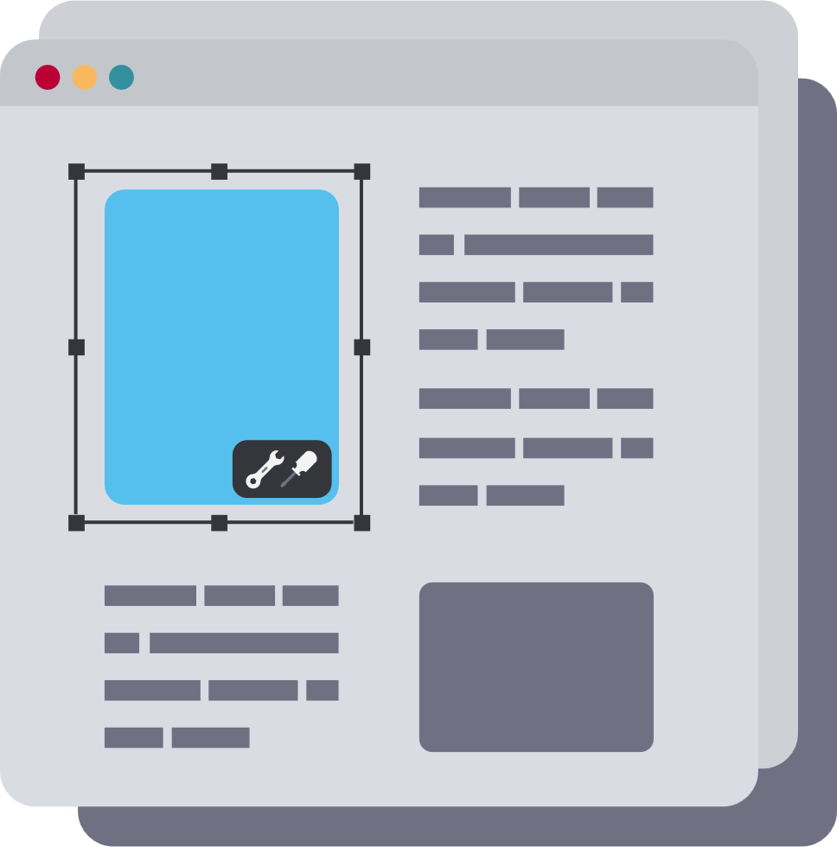




Thanks!
Do you have any questions?
ramiamasha84@gmail.com
https://github.com/RamiAmasha31/rm-video-call
19

